Slide 1
A/V Board
BYUI Fall 2025 Embedded Systems ECEN361
Matthew Spotten, Aidan Pratt, Jared Wightman, Ryan Christensen

Slide 2
Goal
Create an audio/video interface that can:
Control DMX lights
Use faders and key switches to select and control DMX RGBW lights
Connect to an external computer
Send inputs to computer (faders, potentiometers, key switches)
Take outputs from computer (DMX out, key lights, fader motors)
Offer an alternative solution to low-end lighting consoles on the market

Slide 3
Roles
Primary Roles:
Matthew: Design and test hardware
Aidan: Manage orders and implement Ethernet/external connectivity
Jared: Program firmware and demo programs
Ryan: Design case and physical element
Secondary Roles:
Everyone:
Assemble and solder components
Assist other team members with debugging and research
Create presentation materials

Slide 4
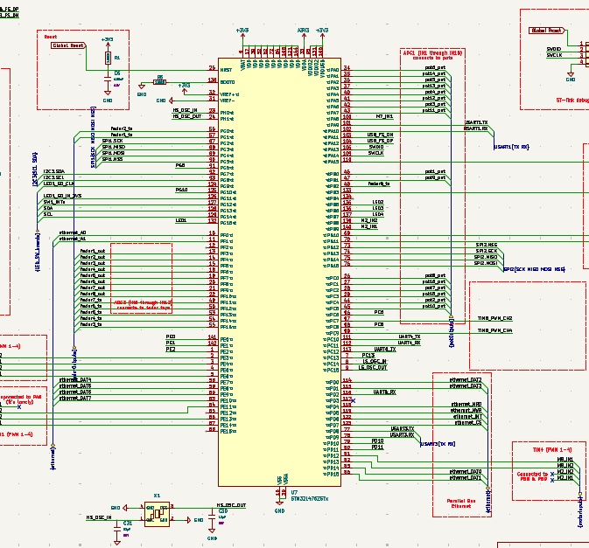
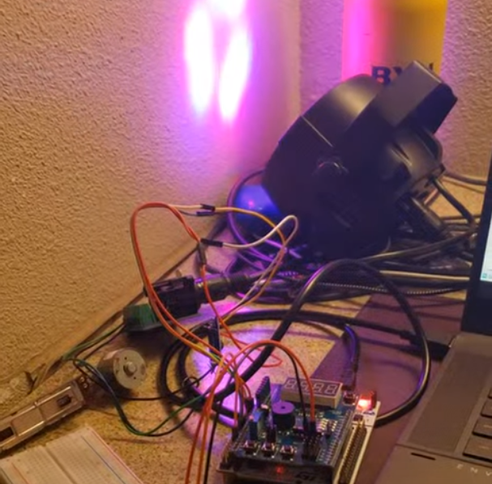
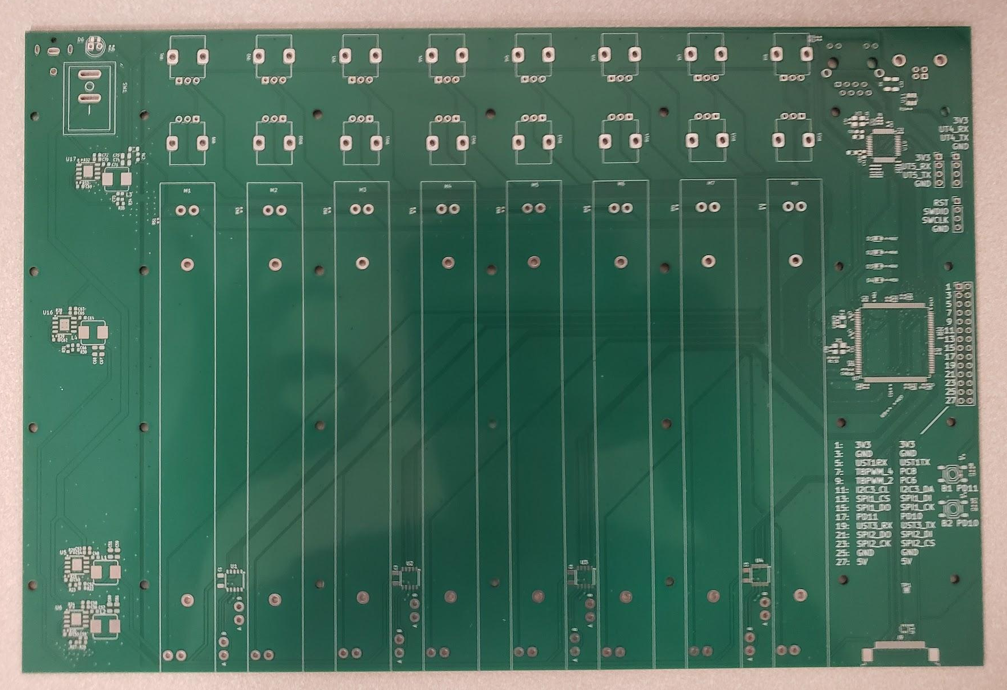
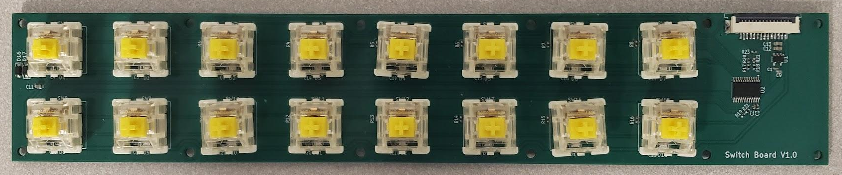
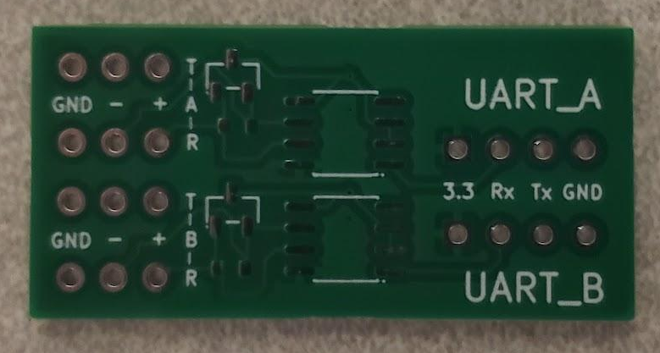
Weeks 1–4: Design Hardware, Write RS485 Firmware
3 PCBs:
Primary board (STM, ports, main mounting chassis, etc…)
Switchboard
RS485 DMX daughterboard

Slide 5
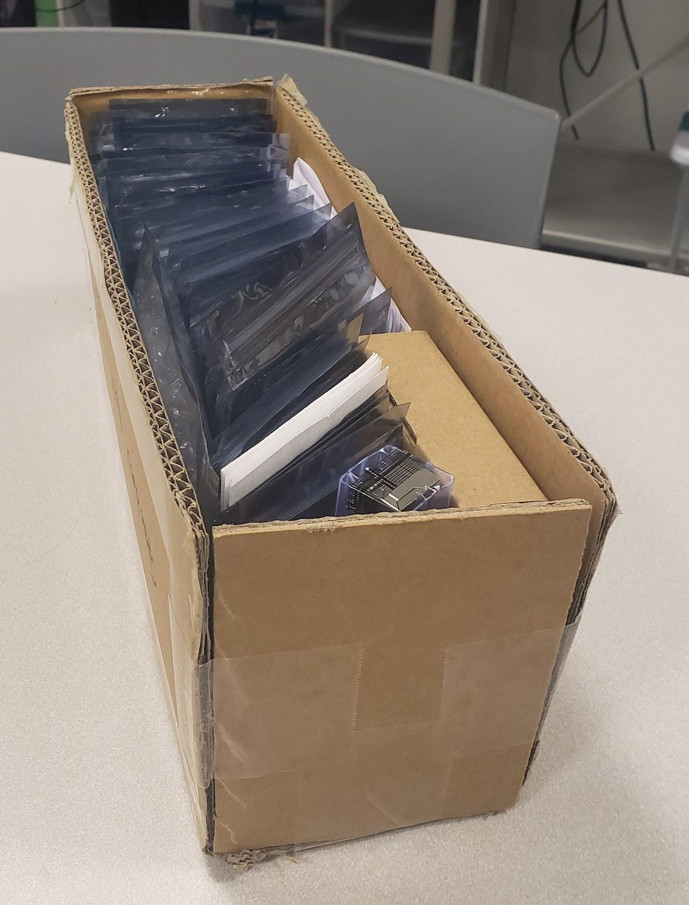
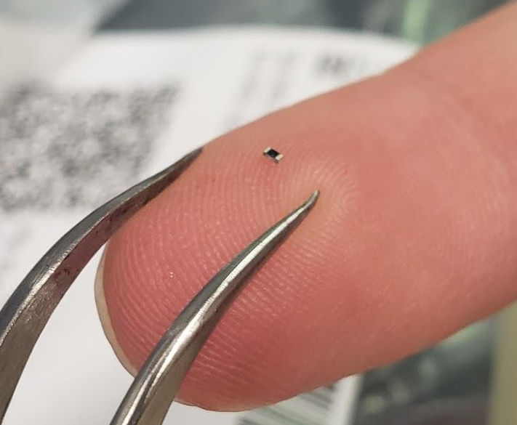
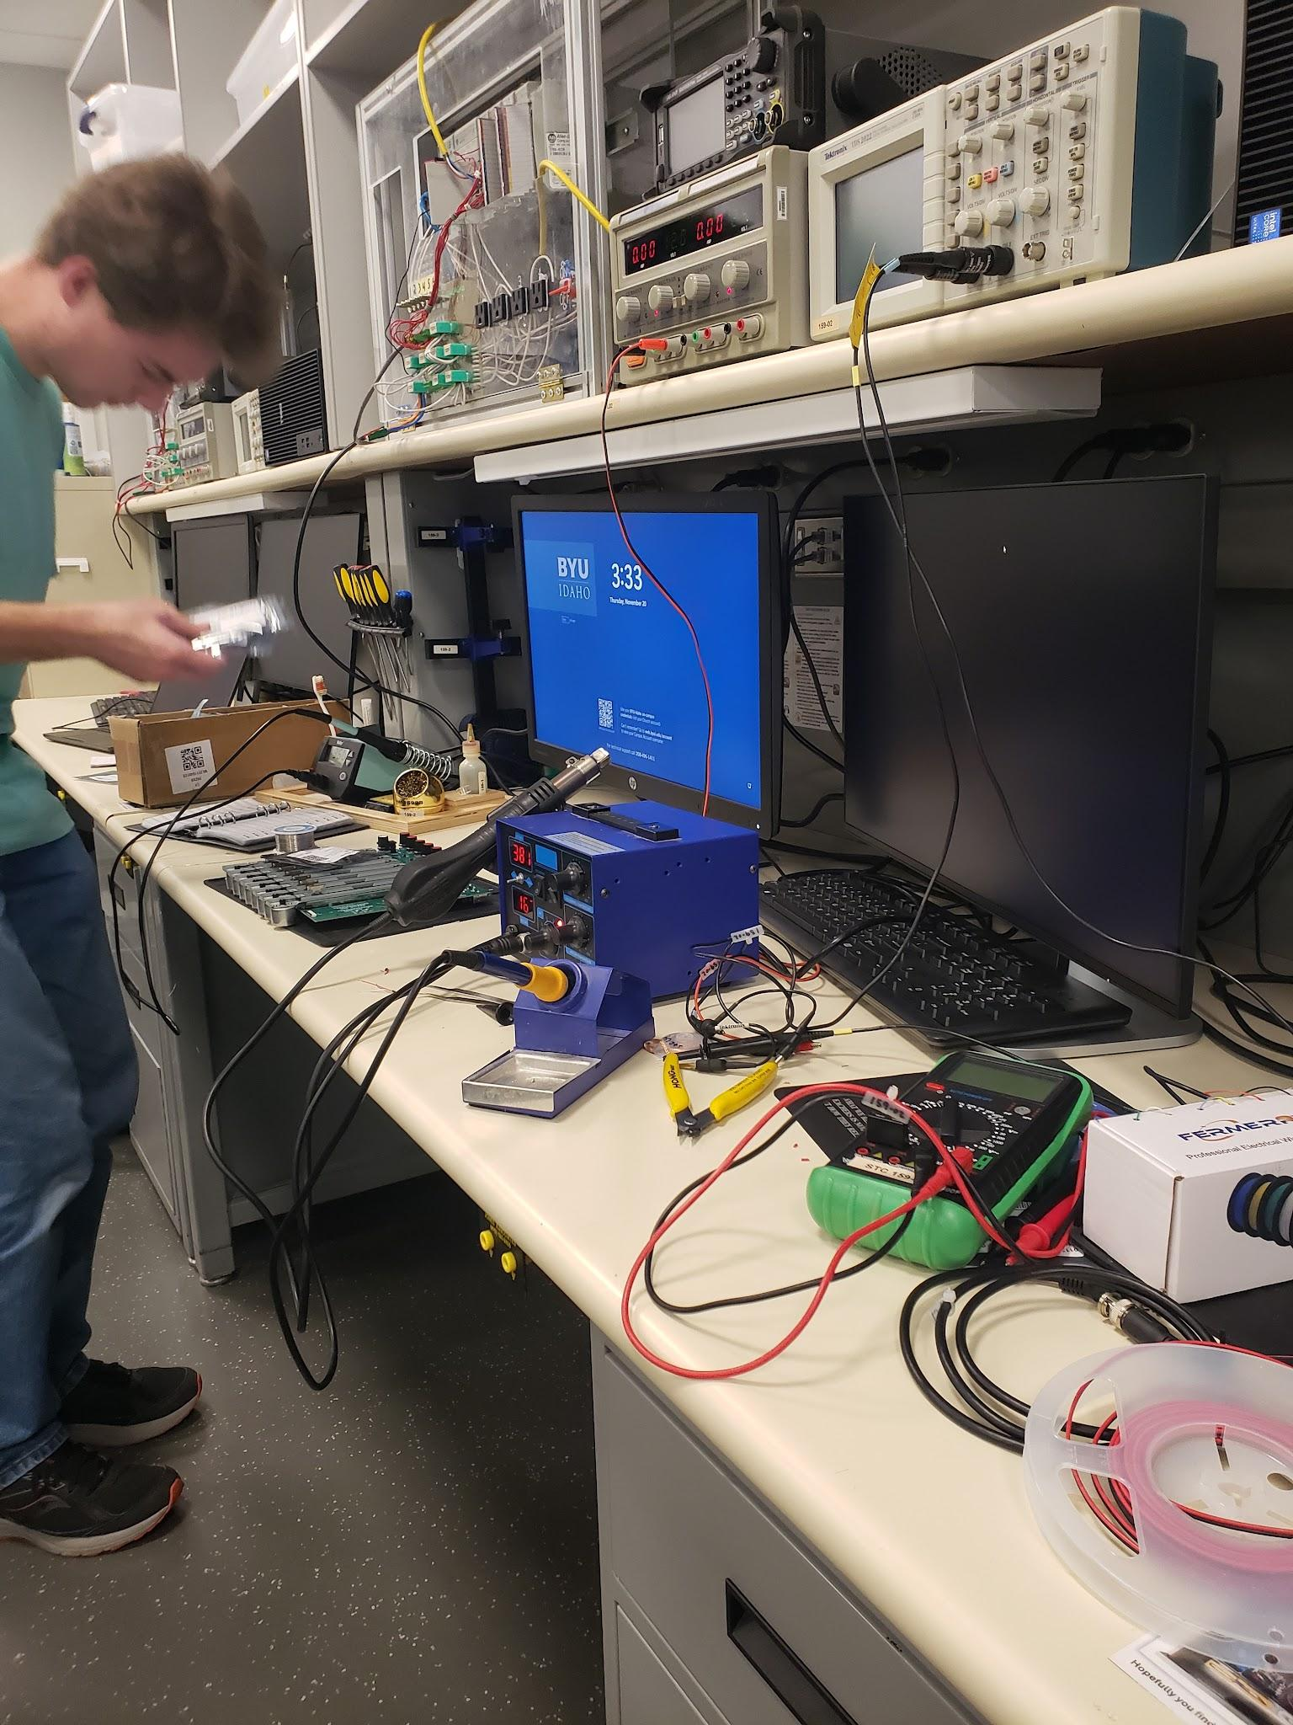
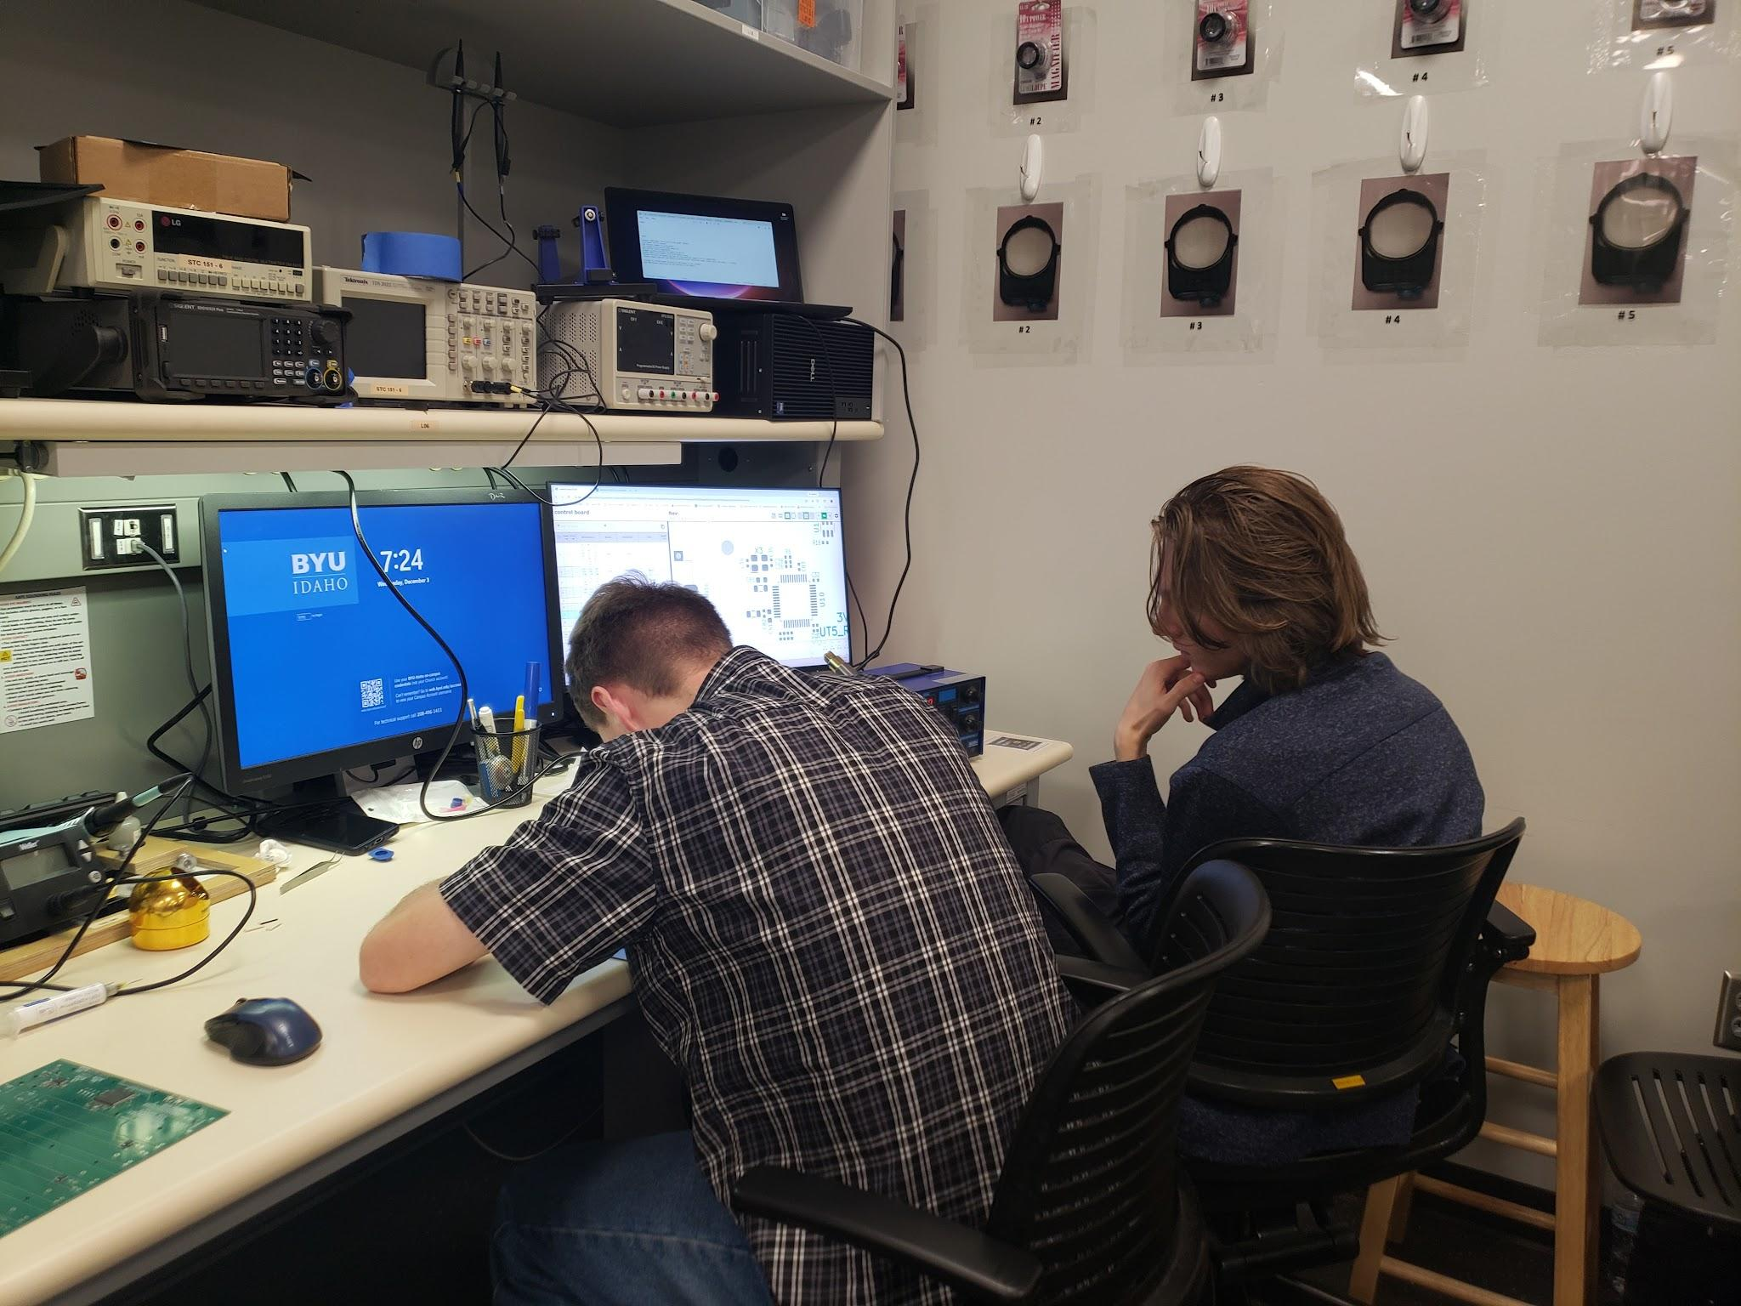
Weeks 5–8: Solder on Components, Test Boards, Diagnose H/W Issues

Slide 6
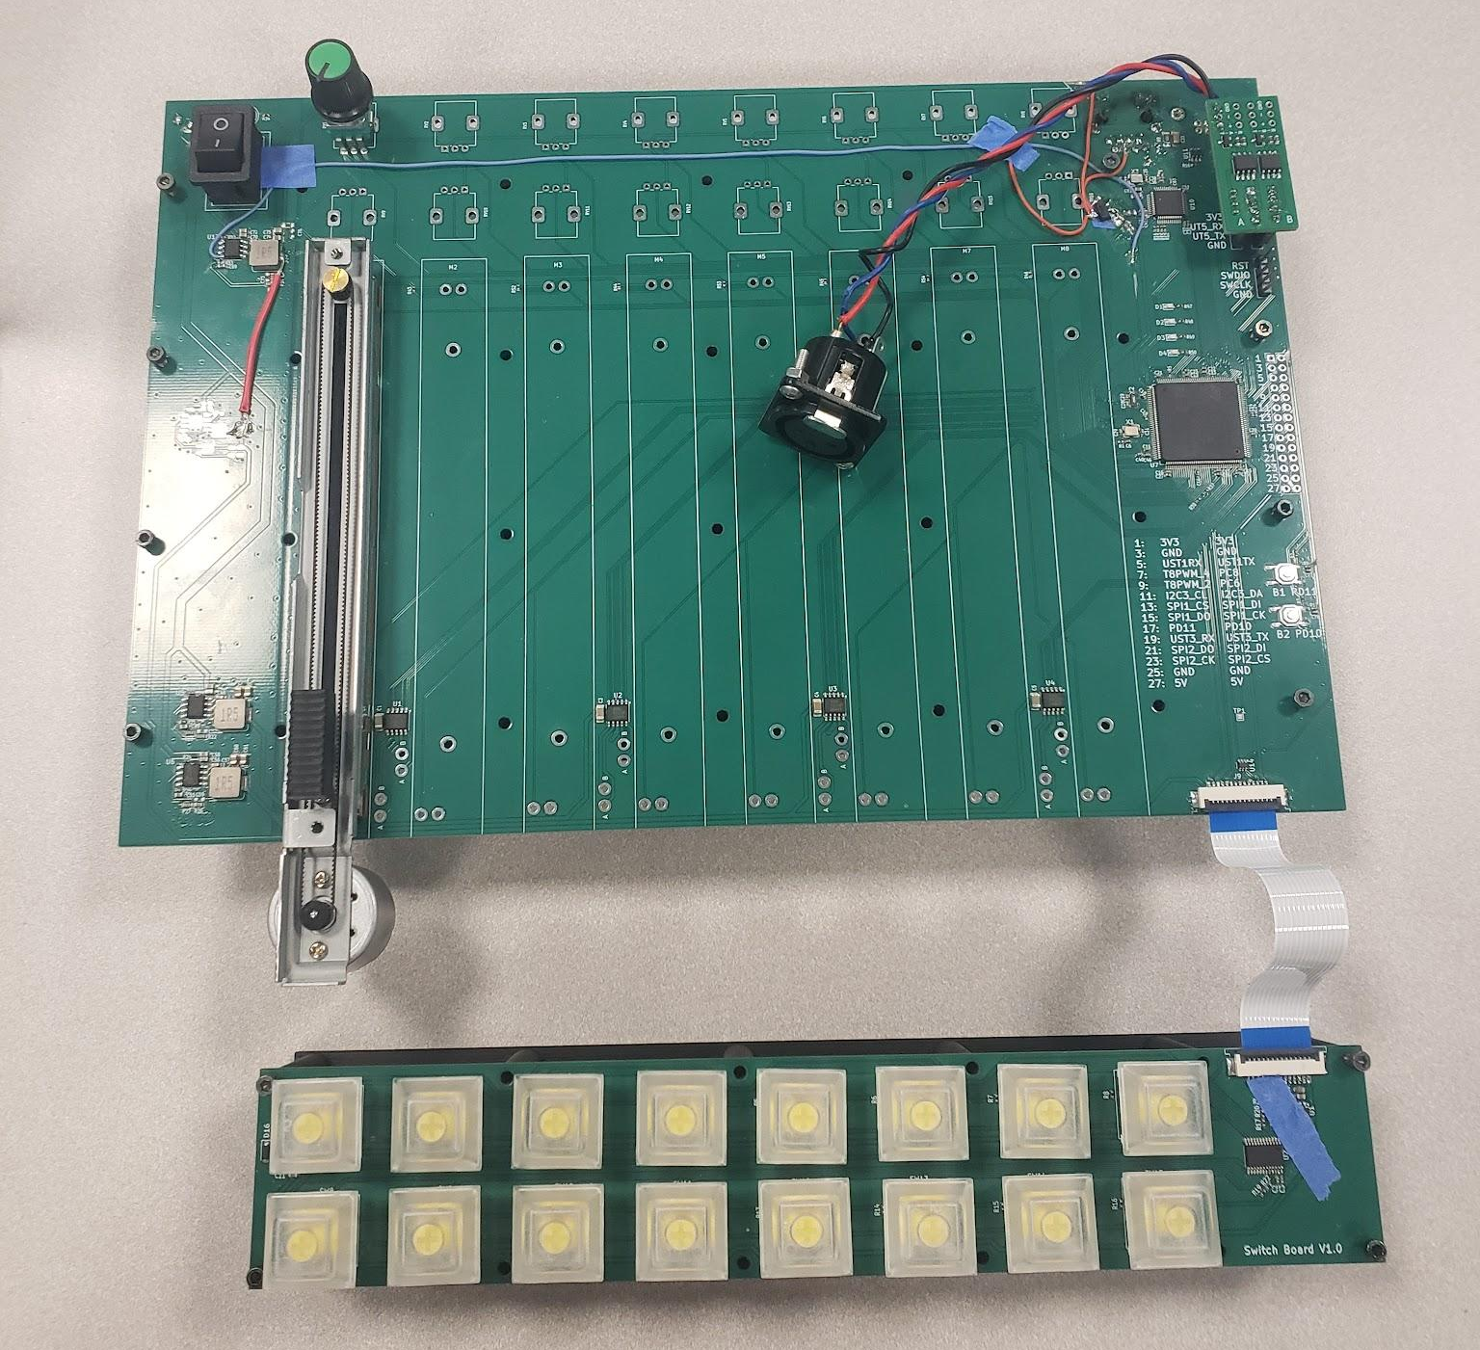
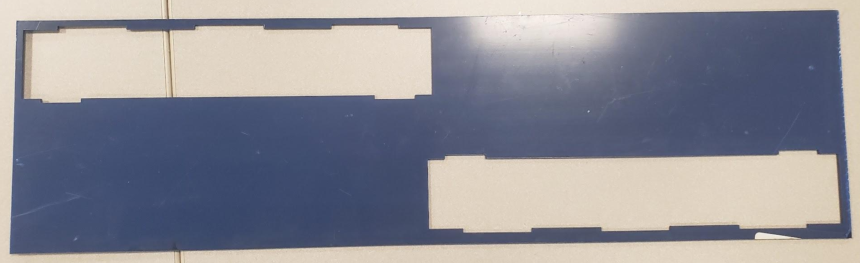
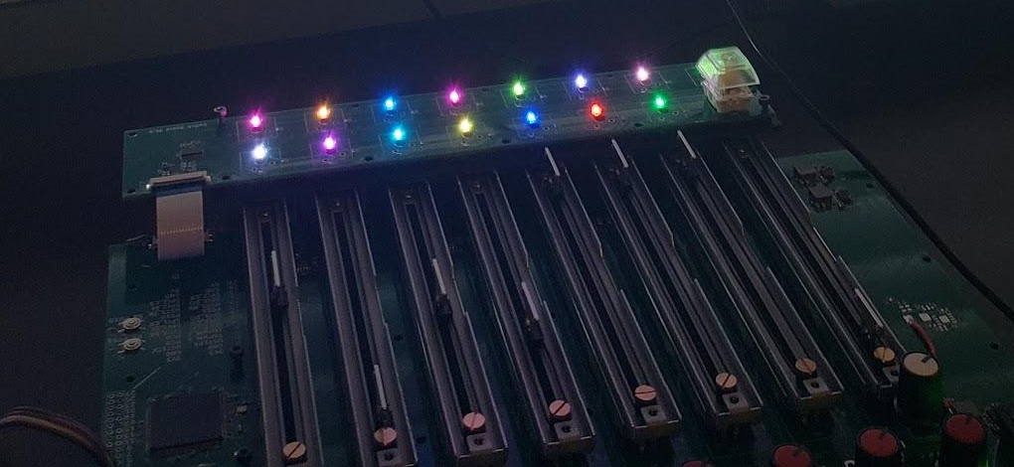
Weeks 9–12: Perform Surgery, Implement/Write Firmware, Begin Design Case, Begin Port Drivers

Slide 7
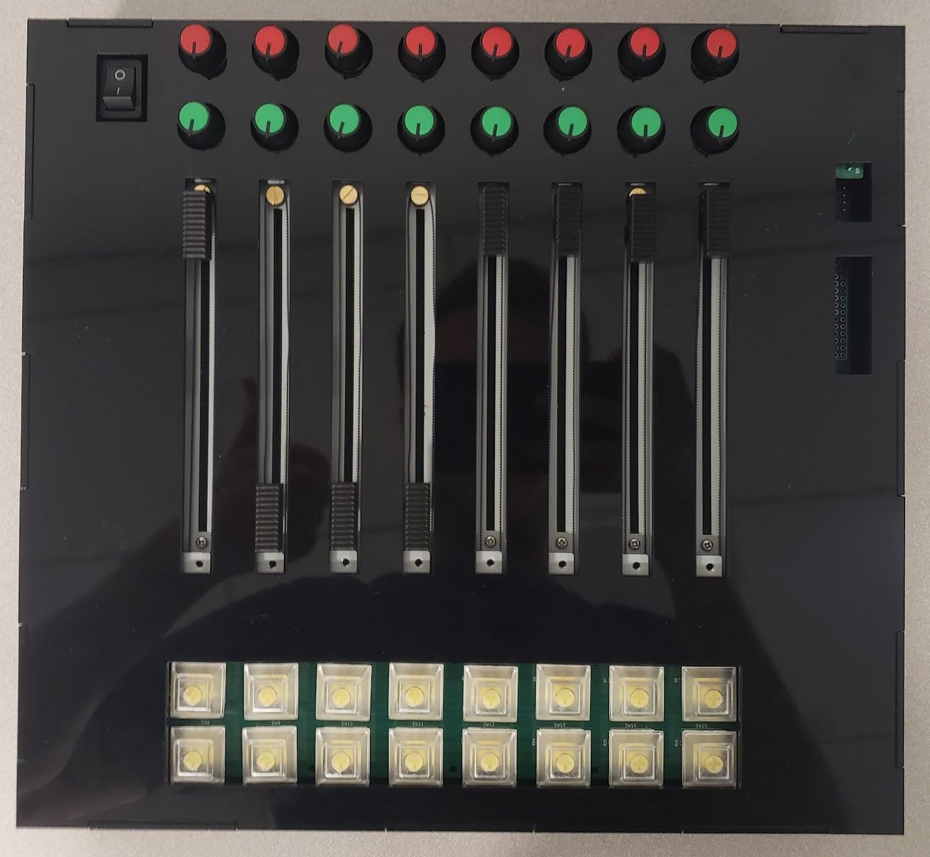
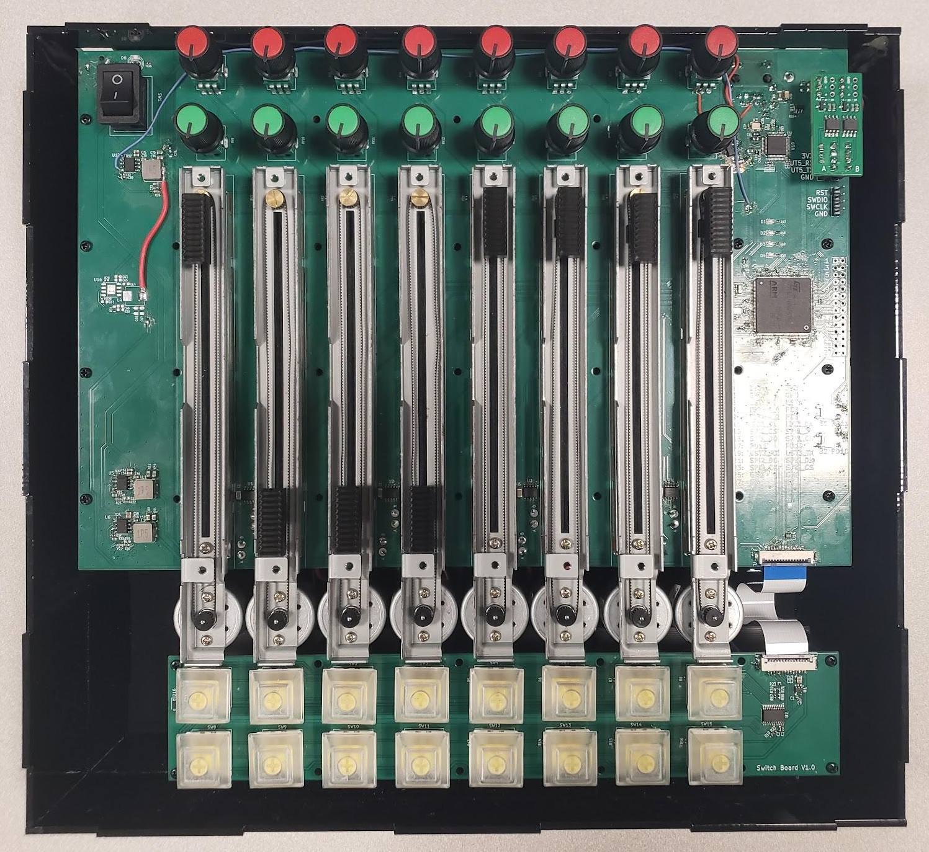
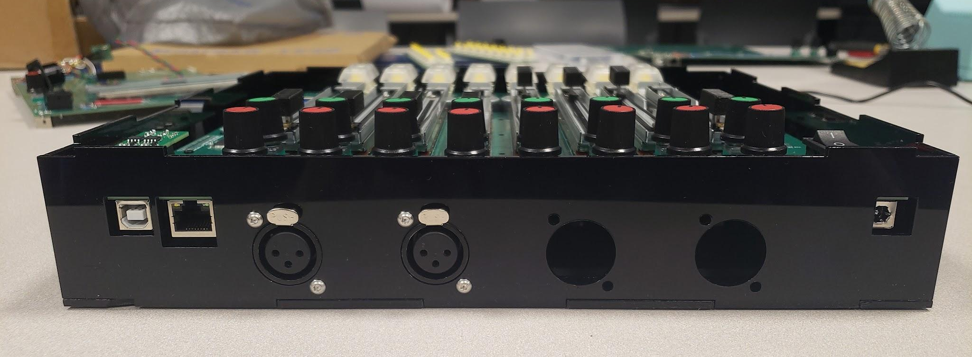
Weeks 12–13: Finish Implement External Drivers, Finish Design Case, Final Assembly

Slide 8
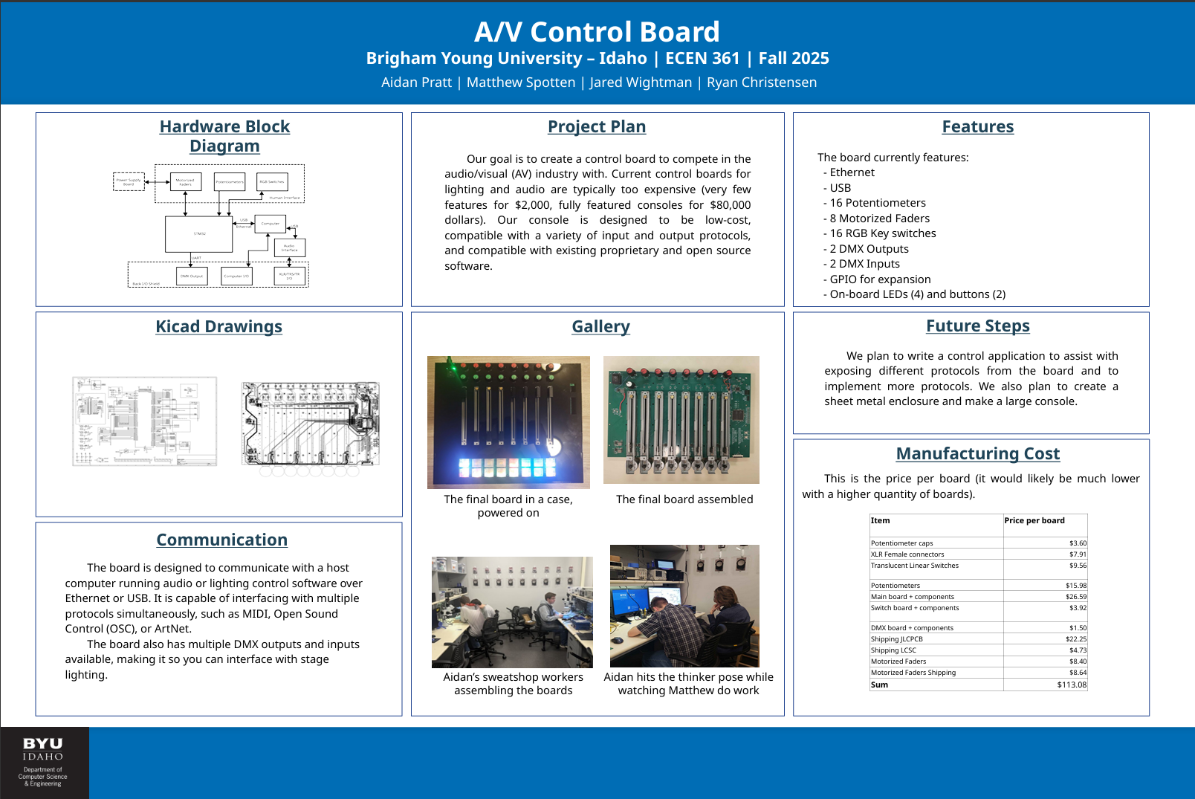
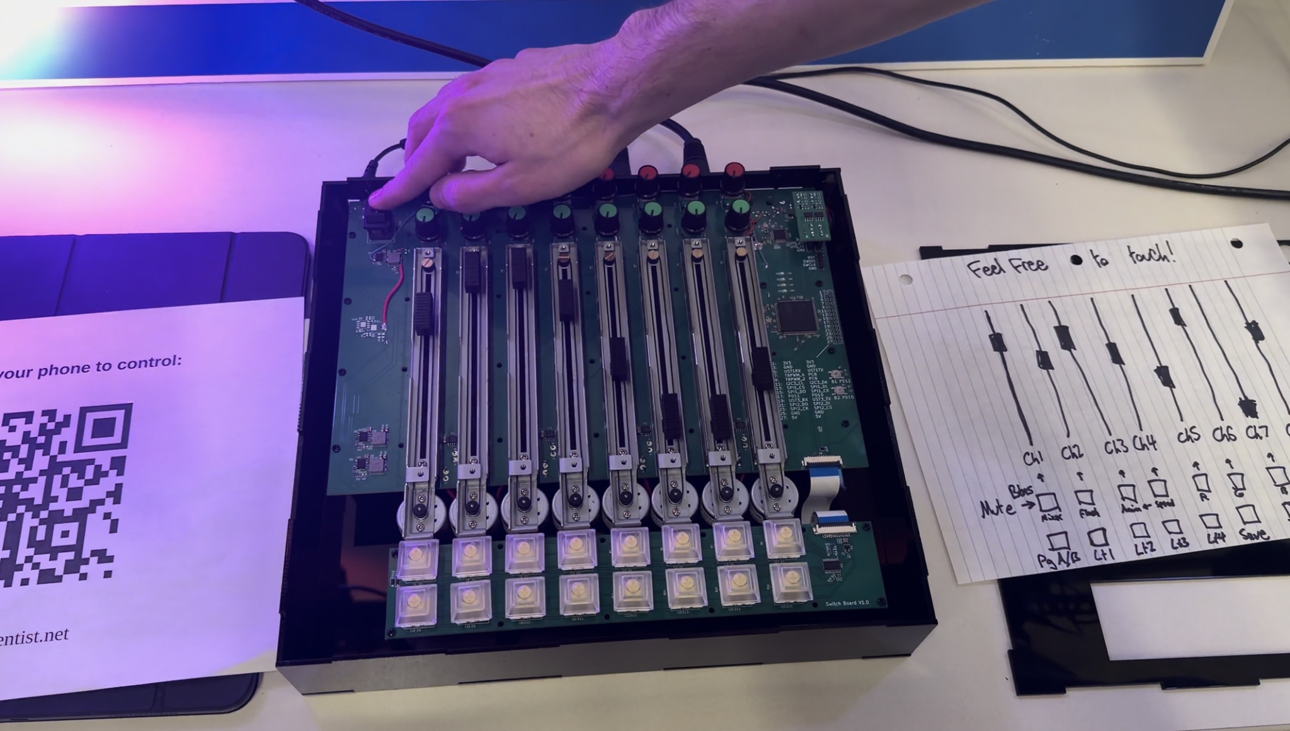
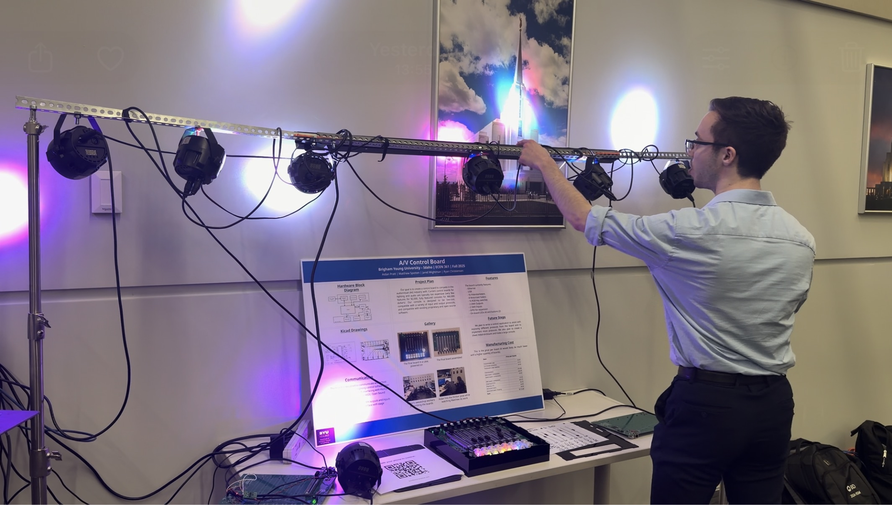
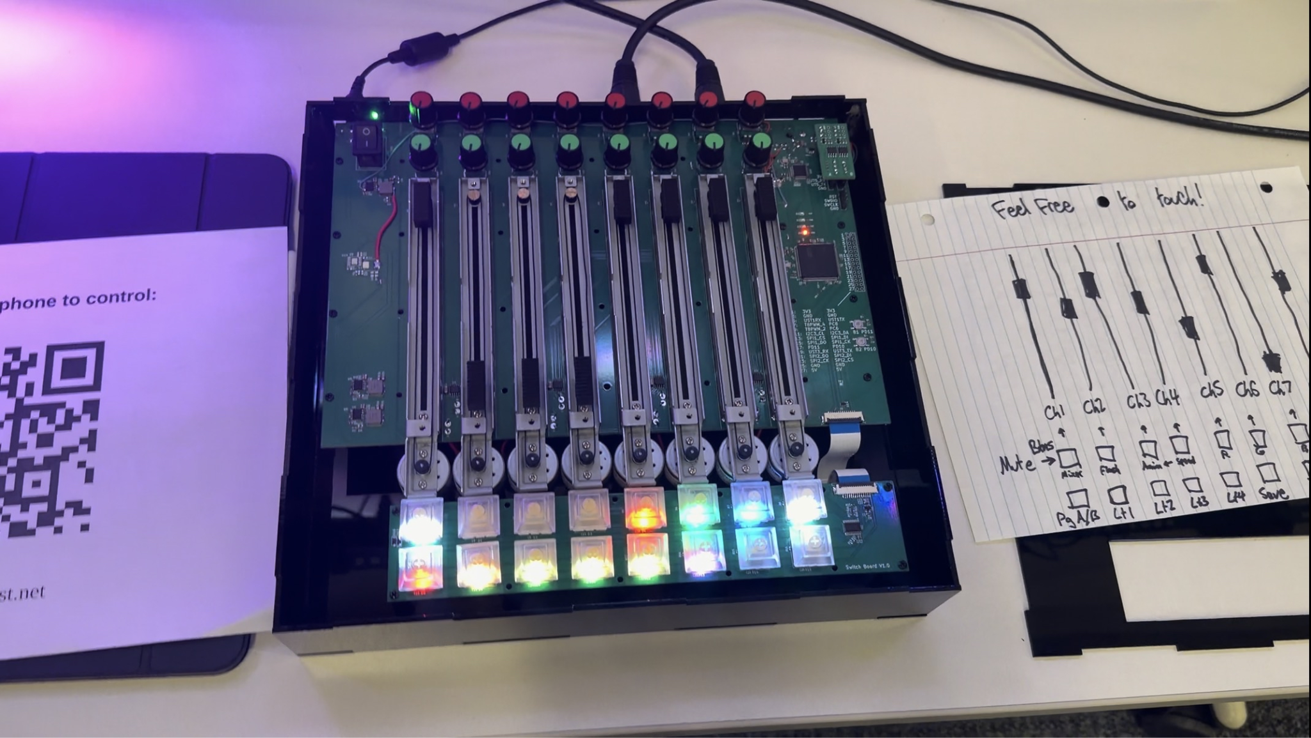
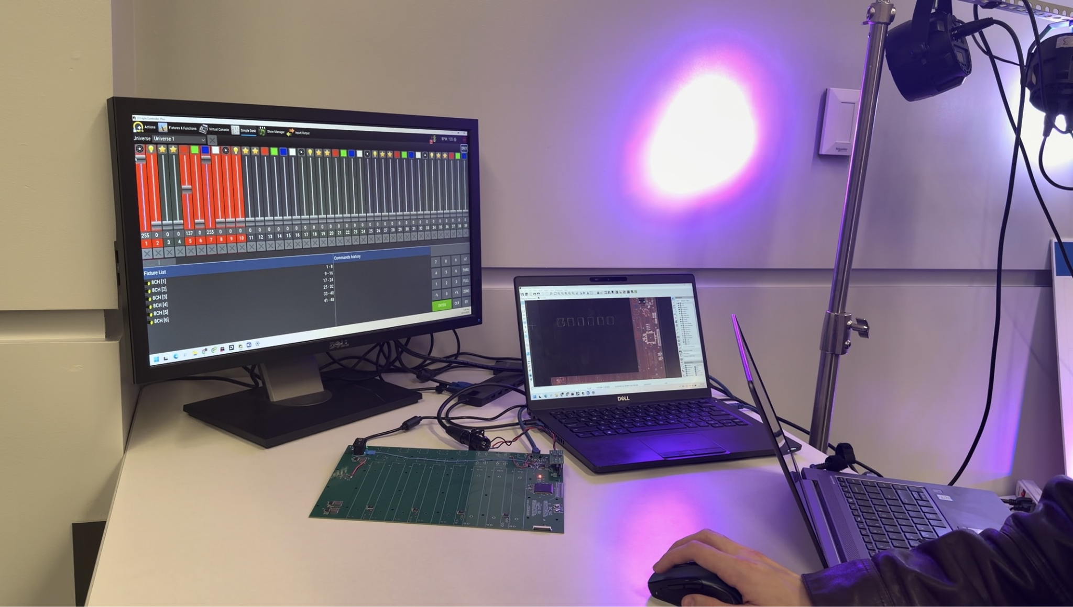
Results

Slide 9
Future Outlook
Update primary schematic to include hardware fixes (no more surgeries)
Modularize sections of Primary PCB, make expandable to link with other consoles and add more rows of faders
Adjust PCB layer heights for switches and potentiometers for flush surface
Pick higher-quality motors and switches, true DMX connectors
Implement DMX receiving
Add on-board audio processing + I/O for a complete standalone mode, rather than all being done on separate computer
Add more external connectivity and drivers for better software interaction
Add more demo animations
Market to consumers: schools, community theaters, churches

Slide 10
Software/Hardware
Software:
STM32CubeIDE
STM32CubeMX
KiCad + Plugins
Notable Components:
STM32L476ZTG6 MCU chip
WS2812B-2020 LEDs
TCA9555PWR I2C chip
W51005-L ethernet chip
B10K potentiometers (sliders and knobs)
RF-33TA-11360 motors
Protocols:
UART → RS485 (DMX lights)
SPI → WS2812 (Switch LEDs)
I2C (Key switches)
FMC (Ethernet)

